Slide 1
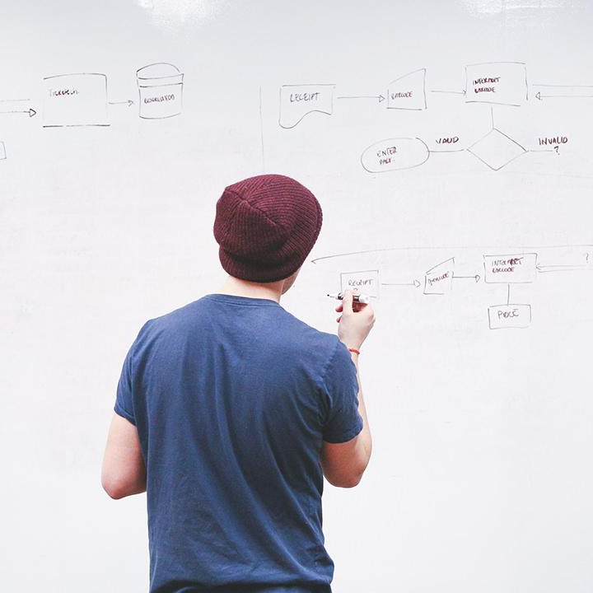
HELLO!
Here 1Crore Projects
I am here because I love to give presentations.
You can find me at @1CROREPROJECTS

Slide 2
Data Trust Framework Using Blockchain Technology and Adaptive Transaction Validation

Slide 3

AIM OF PROJECT
The main aim of the project to identify a block chain by a different block for the data and maintain safe mood when attackers attack the particular block means the user can Recover to Safe mood using Particular Block chain.

Slide 4
ABSTRACT
This project presents an end-to-end framework for data trust to enhance trustworthy data sharing utilizing blockchain technology. The framework promotes data quality by assessing input data sets, effectively manages access control, and presents data provenance and activity monitoring.
We introduce an assessment model that includes reputation, endorsement, and confidence factors to evaluate data quality. We also suggest an adaptive solution to determine the number of transaction validators based on the computed trust value.

Slide 5
INTRODUCTION
Data trust is a fairly new concept that aims to facilitate data sharing by forcing data users to be transparent about the process of sharing and reusing data.
Blockchain can be used as a data trust interface between data controllers and data users. The distributed, secure and reliable nature of the blockchain can reinforce the trustworthiness of the data trust framework.
Blockchain provides a secure, immutable record of transactions, and all blocks are linked together through their hash values.

Slide 6
EXISTING SYSTEM
In before years the data does not save as in safe mood, the attackers are attack it directly and we cannot recover the data issues.
A decentralized architecture based on blockchain technology provides the ability to solve above issues

Slide 7
DISADVANTAGES
Lows of security
The user without login, Encrypted data cannot store in block chain

Slide 8
PROPOSED SYSTEM
We propose an end-to-end framework for data trust based on blockchain, which ensures the trustworthiness and quality of the data at origin for data users and ethical and secure usage of data for data owners.
We introduce a trust model to assess input data sets’ trustworthiness using three parameters: data owner endorsement and reputation, data asset endorsement and data owner confidence level in the provided data set.

Slide 9
ADVANTAGES
Data was secure
By the different fields create a unique block is used to search a user need.

Slide 10



SYSTEM ARCHITECTURE
Register and login
Authorized user
Login
View and buy now all product view transaction details
Upload all product details
Send request view all product details

Slide 11
MODULES
In this project have 2 modules:
Admin
User

Slide 12
User
Register the account with the basic information
Login the account with the correct credentials
View user product details
View product and buy now all products
View product response
Logout

Slide 13
Admin
Login
Add the product details
View manage product
View New orders
View Prediction based on review
View fake products
View Graph details
Logout

Slide 14
HARDWARE REQUIREMENTS
System | Intel i3 and above
Hard Disk | 40GB
RAM | Minimum 4GB
Processor | 64-bit, four-core, 2.5 GHz minimum per core

Slide 15
SOFTWARE REQUIREMENTS
Front End Language | HTML, CSS, JAVA, JSP SERVELTS
Backend | My SQL
Operating System | Windows 10 or 11
IDE | JAVADEVELIPEMENKIT

Slide 16
FUTURE WORK
As a future direction, we are looking toward improving the credibility of our framework by adding incentives to encourage honest participation of the users by adding endorsements and ratings

Slide 17
CONCLUSION
Evaluation results indicate the system’s effectiveness in handling a large number of transactions for writing, updating, and querying trust parameters value.

Slide 18
REFERENCE
[1] K. O’hara, ‘‘Data trusts: Ethics, architecture and governance for trustworthy data stewardship,’’ Univ. Southampton, Southampton, U.K., Tech. Rep., 2019.
[2] A. Alsaad, K. O’Hara, and L. Carr, ‘‘Institutional repositories as a data trust infrastructure,’’ in Proc. Companion Publication 10th ACM Conf. Web Sci., Jun. 2019, pp. 1–4.
[3] S. Rouhani and R. Deters, ‘‘Security, performance, and applications of smart contracts: A systematic survey,’’ IEEE Access, vol. 7, pp. 50759–50779, 2019.

Slide 19
THANKS!
Any questions?
You can find me at
Reach us – 1croreprojects@gmail.com
Contact / Whatsapp: 7708 150 152 / 9751 800 789 / 790 432 0834

